Slide 1
HUMAN ACTIVITY RECOGNITION IN SPACE USING LOW COST SENSORS
DIY PROJECT
TEAM 14

Slide 2
TEAM MEMBERS
DEVADATH K (20ME10038)
SAURABH PATEL (20ME10076)
AMAN KUMAR (20CH10006)
ISHAN SINGH (20CH10026)

Slide 3
COMPONENTS REQUIRED
Arduino uno R3
Ultrasonic distance sensor
Decibel sensor
LED bulb
Resistor
Breadboard
Jumper wires

Slide 4
Did you get all components for project?
YES,
We received all components for the project on 16th June.

Slide 5
PROJECT STATUS : WEEK 1
Discussed about the project
Distribute the total project work to all the team members
Decided the components required for project
We had 3 meets in 1st week and we had gone through each others work.
Every members are actively participating.

Slide 6
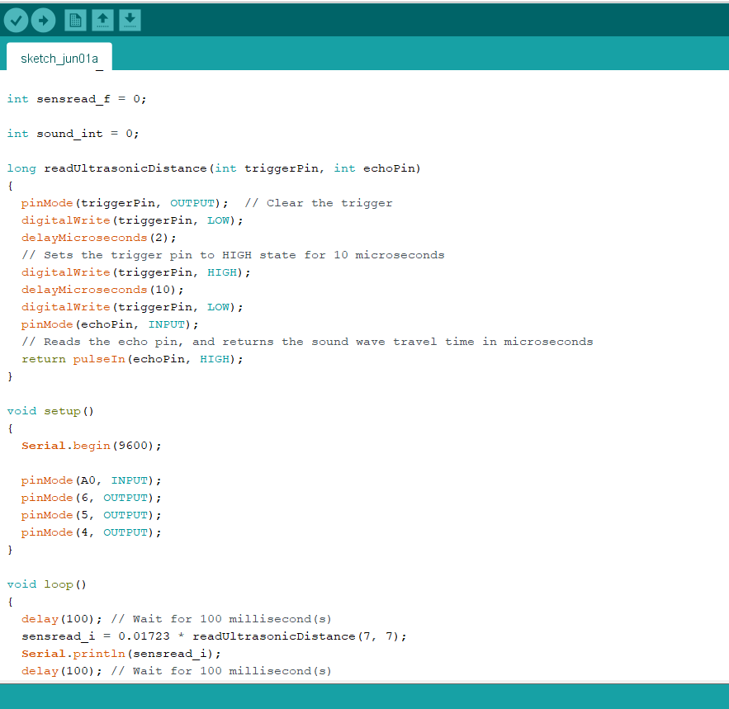
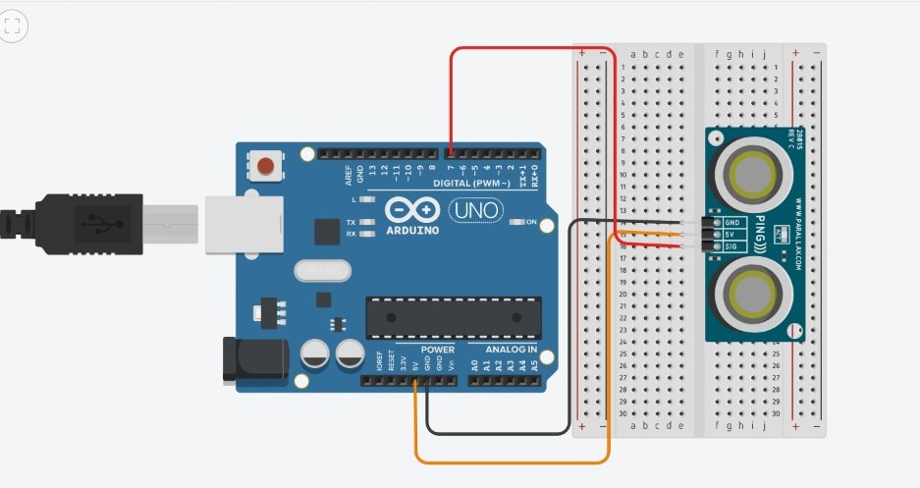
CURRENT STATUS OF THE PROJECT
The components required for the project was delivered.
We designed circuit for ultrasonic and sound sensor individually and study about its function
Write code for each sensor
We will combine it to get the best possible output.

Slide 7
ISSUES FACED
We faced issue with the simulating software.

Slide 8
INDIVIDUAL CONTRIBUTION TO THE PROJECT
Aman Kumar : Designed the circuit for our project and worked on simulation of the circuit.
Saurabh Patel : Ordered and received components , designed circuit and coded for ultrasonic sensor.
Devadath K : Combine the individual code and modified it and made PPT for this week presentation.
Ishan Singh :Write code for sound sensor.
In this week hardware components was not delivered,
So we all focused on the software part(Designing and coding).

Slide 9
THANKYOU

